Slide 1
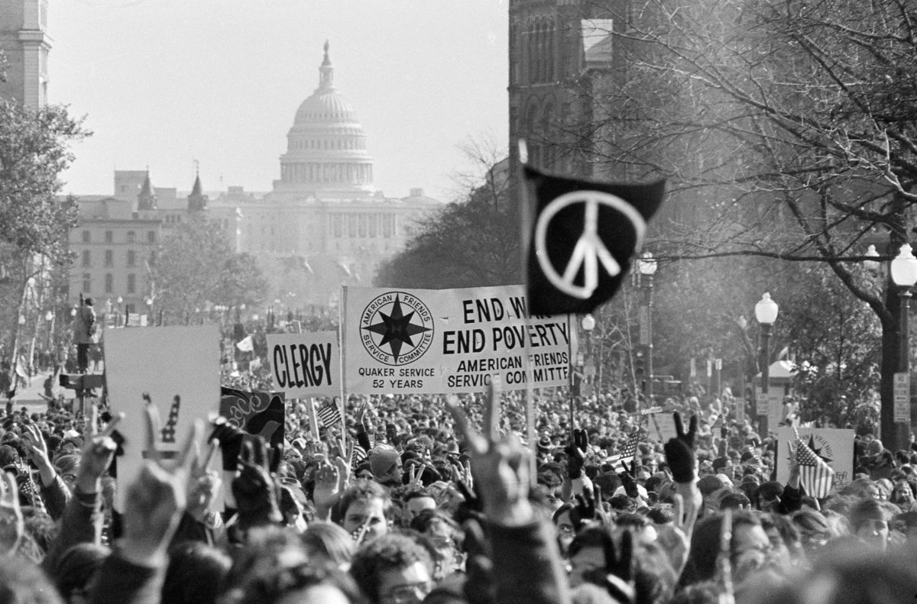
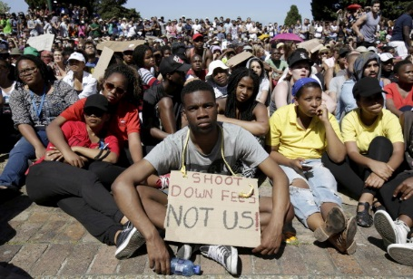
Are protest movements effective ways to bring social and political change?
Kaleigh Anastasia

Slide 2
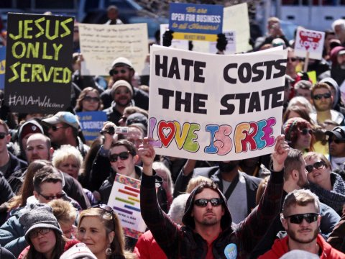
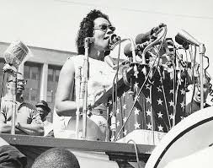
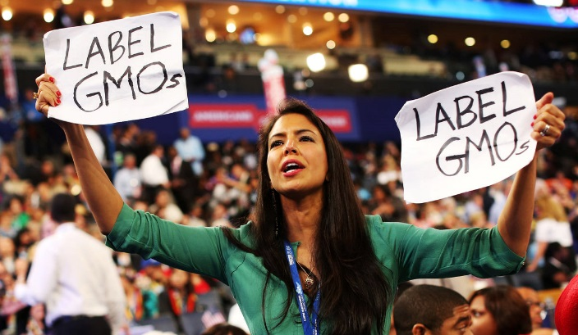
What is a protest movement?
A large or small group of people getting together in a public area or on the streets to express their opposition to a policy, leader, or an idea.

Slide 3
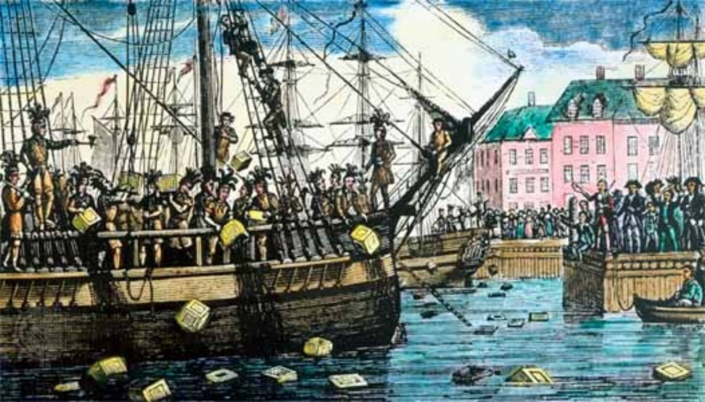
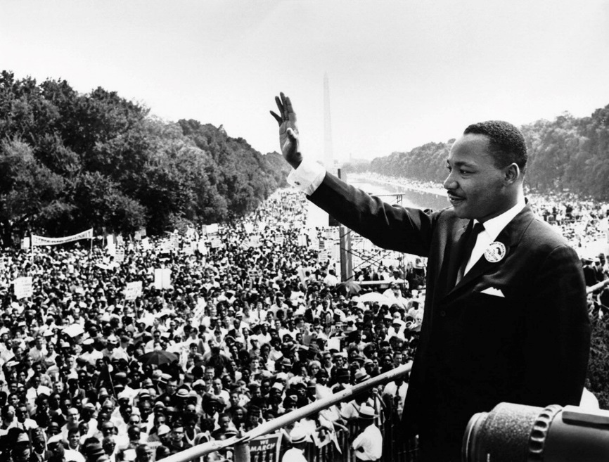
Protests throughout history that succeeded in making a change
The Boston Tea Party 1773
Opposing the Tea Act (gave Britain too much power)
Protesters disguised themselves as Native Americans
Dumped 342 barrels of tea into the Boston Harbor.
Did this work? – Yes. Britain eventually got rid of the Tea Act shortly after this protest.
Martin Luther King’s Civil Rights March on Washington and civil disobedience (Sit ins, boycotts.) 1963
Led more than 200,000 people on a march on Washington D.C.
Delivered his “I Have a Dream” speech
He also led boycotts (Montgomery Bus boycott) and peaceful sit-ins (restaurants, movie theaters, etc.)
Did this work? – Yes. Although there is still racism today, no matter what color you are, in America we now have equal rights.

Slide 4
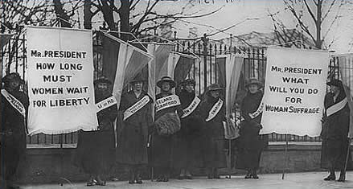
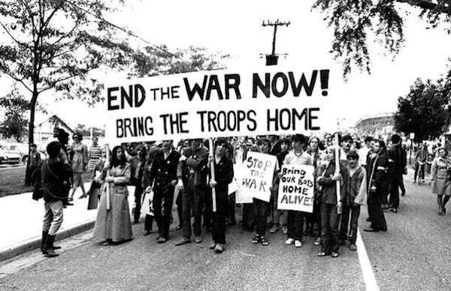
More Protests throughout history that succeeded in making a change
Suffragist Movement: 1916
Battle to give women the right to vote
In the U.S. this involved many marches
Did this work? – Yes. There was hope President Woodrow Wilson would urge Congress to pass an amendment giving women the right to vote. Legislators passed the 19th Amendment.
Vietnam War Protests: late 60’s early 70’s
End America’s involvement in Vietnam War
Involved large demonstrations in Washington and on college campuses
Did this work? – Yes. Many people believe it was the single biggest factor in the U.S. withdrawing from Vietnam.

Slide 5
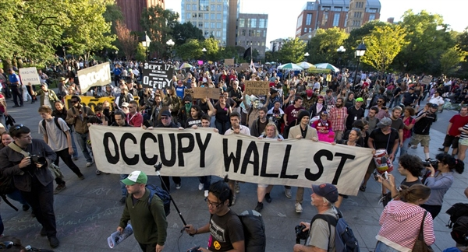
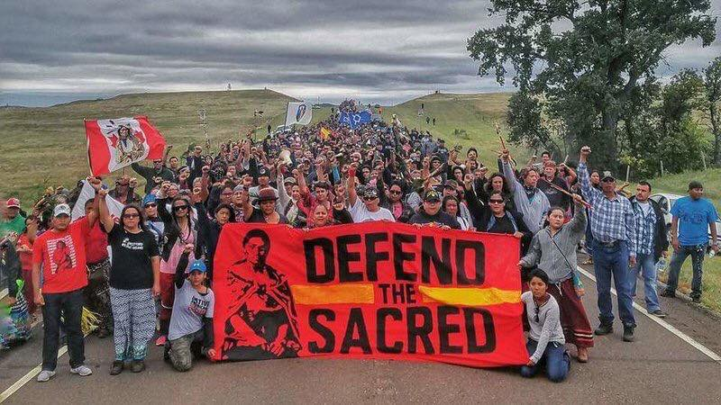
Protest Movements throughout history that didn’t work out
Occupy Wall Street – 2008
The action of big banks on Wall Street contributed to one of the largest economic downfall since the Great Depression (1930s)
Large groups set up camps in different economic centers – mainly Wall Street
Did this work? – Not quite. There was no clear cut leadership, it was not organized, and the demands were not very clear.
Standing Rock – 2017
Protest to restrict access of Dakota Access Pipeline across sacred Native American Lands
Corps of engineers declined access under President Obama, after President Trump took office, granted access and forcefully removed protesters
Did this work? – No. The pipeline is being built across Native Lands.

Slide 6
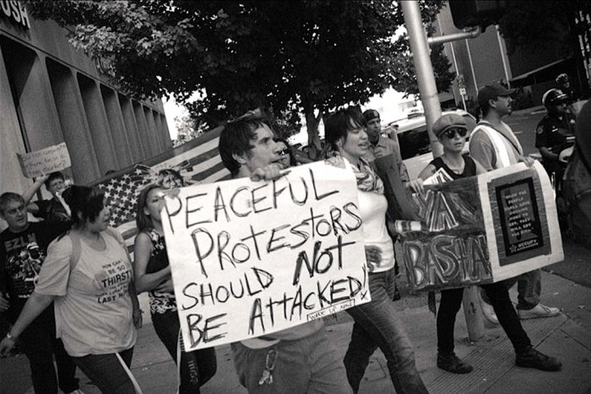
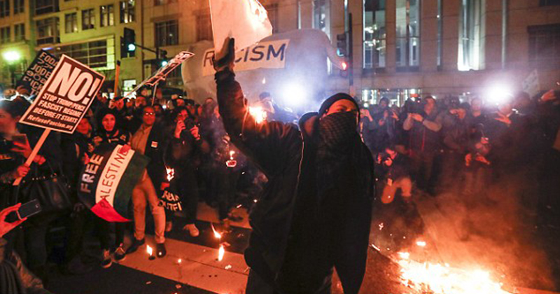
Pros and Cons of Protests:
Cons
Can turn violent
Strengthens the opinions of opponents
A successful result can have unsuccessful consequences (Temperance Movement)
Pros
Voices being heard
Can be a peaceful way to oppose a problem
Healthy for the Democratic process.

Slide 7
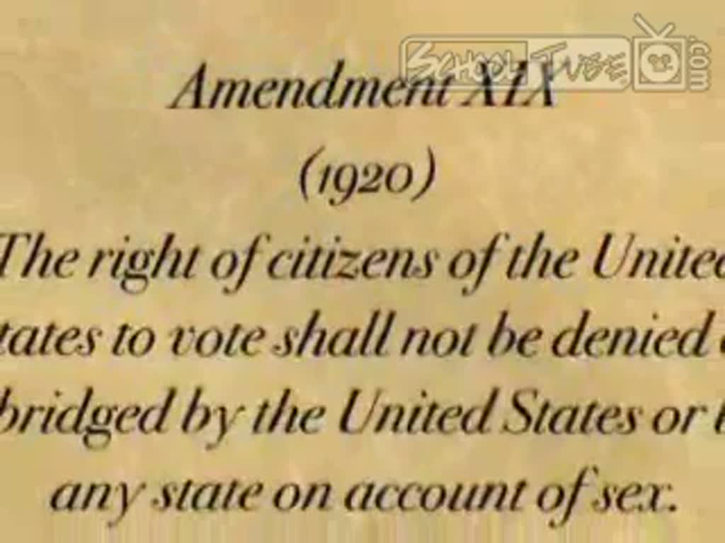
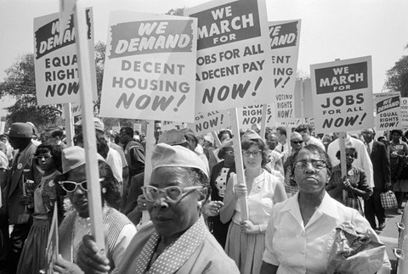
Determining success or failure of Protests:
The more specific the goal, the easier to determine outcome
Ex. Suffragist Movement: The right to vote. It was granted.
The broader the goal, the harder it is to determine outcome
Ex. Civil Rights Movement: There have been some success, not all objectives achieved.

Slide 8
Opponents Opinions on Protest Movements:
“Some government leaders are not concerned with people sitting in tents or cheering outside in the freezing cold, they know you’re eventually going to just go home.”
“If people want to make a difference, they need to be felt. Not just seen and heard.”
“If protesters want to make a difference in their government, become an informed voter. Study the issues and become familiar with both sides.”

Slide 9
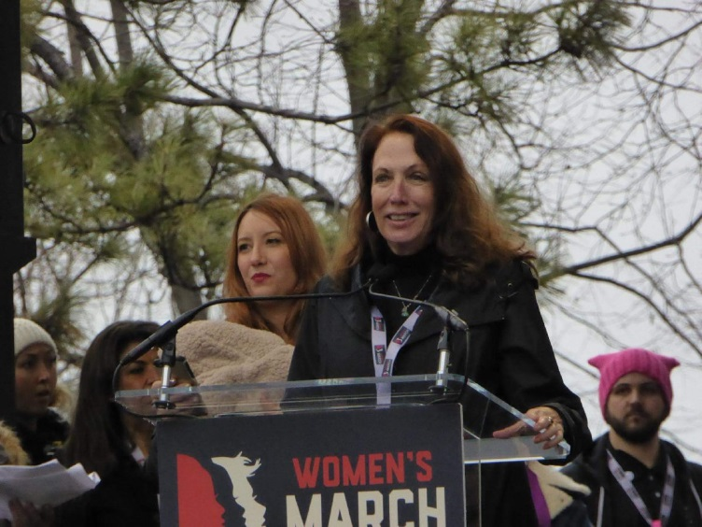
Social Media’s Impact on Protest Movements
A woman named Teresa Shook from Hawaii came up with an idea the day Donald Trump became president of the United States (November 8th, 2016.) This idea was called the Women’s March on Washington. (January 20th, 2017.)
Shook created a Facebook event page calling for a march on Washington.
That same night she got 40 responses. When she woke up, she had over 10,000.
Later there became a Women’s Rights Website to be more organized.
Not only was there a march on Washington but all around the world.
Crowd Scientists estimated half a million people came to the march in Washington alone.
Because of Social Media, there were marches all around the world that day, not just the United States.

Slide 10
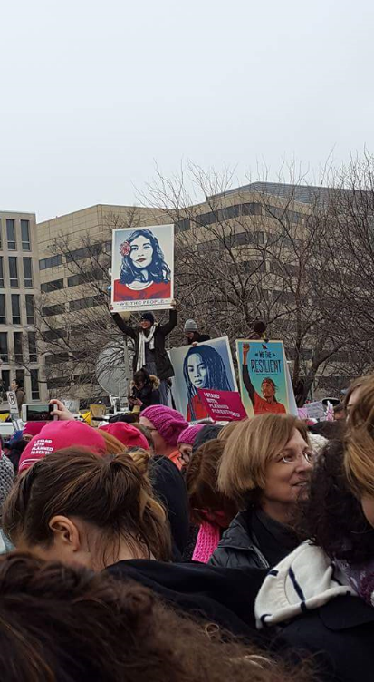
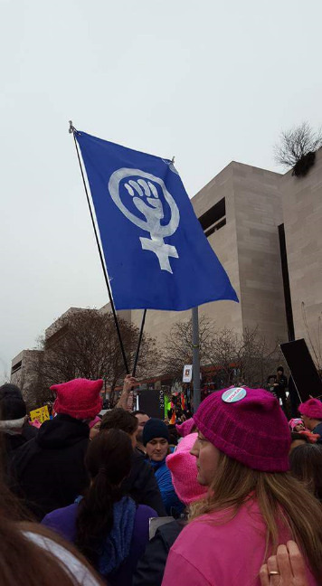
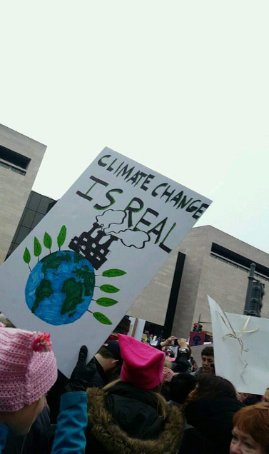
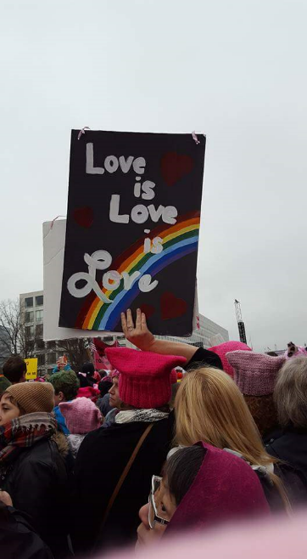
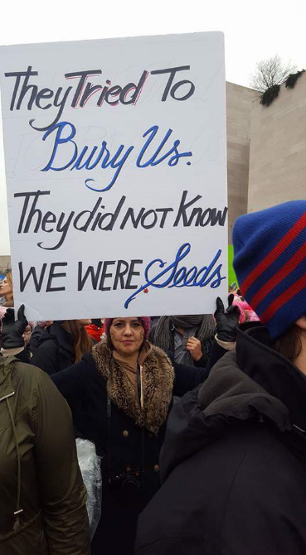
WOMEN’S MARCH ON WASHINGTON

Slide 11
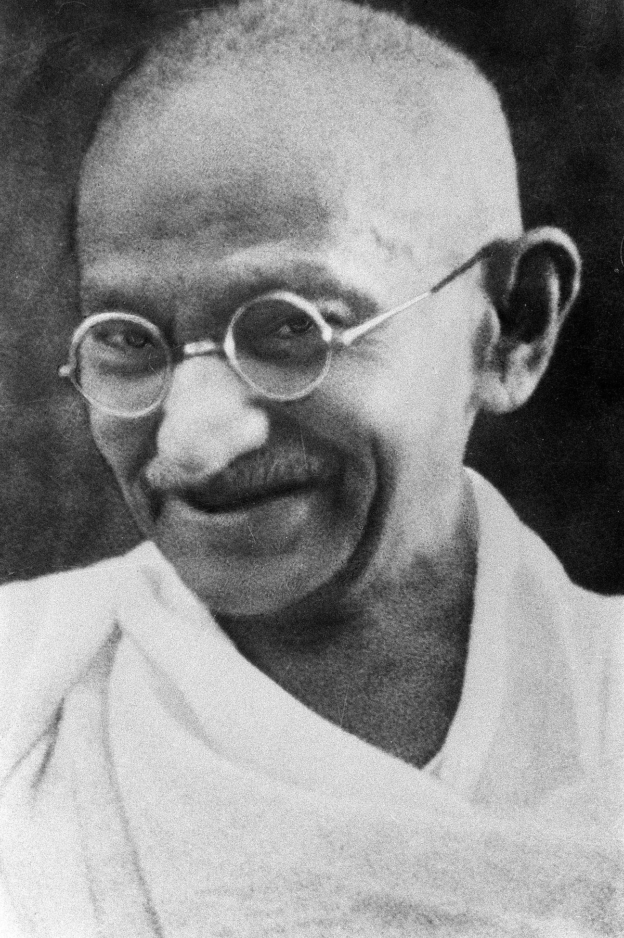
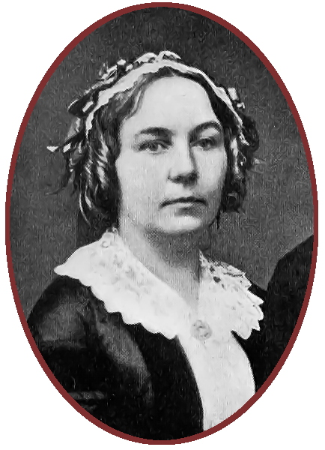
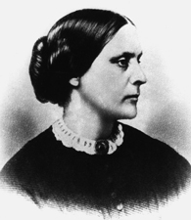
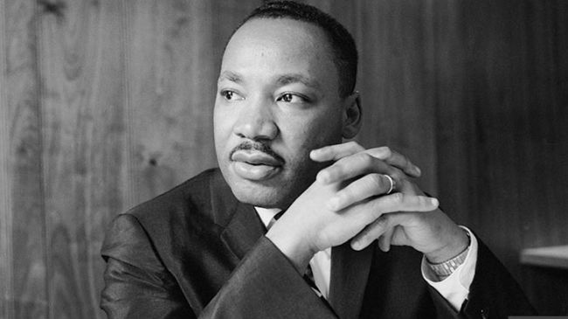
In Conclusion
Many Protest Movements throughout history have succeeded in making a social and political change.
Some Leaders who are famous from protests they have lead and the difference they made:
Martin Luther King Jr. – civil rights activist, known for civil disobedience
Mahatma Gandhi – civil rights activist, known for civil disobedience
Elizabeth Cady Stanton – suffragist, social activist
Susan B. Anthony – suffragist, women’s rights activist

Slide 12
Works Cited
“Protest Movements: Are Protest Movements Effective Ways of Bringing about Social and Political Change?” Issues & Controversies, 6 Feb. 2012, Facts on File, icof.infobaselearning.com/icofprintarticle. Accessed 14 Feb. 2017.
“Readers’ Thoughts on ‘Occupy’ Movements.” Statesman Journal. Proquest, search.proquest.com/gannettnews/printviewfile?accountid=37636. Accessed 16 Feb. 2017.
Weldon, Laurel S. “When Protest Makes Policy: How Social Movements Represent Disadvantaged Groups.” Critical Dialogue, vol. 10, no. 3, 3 Sept. 2012. Proquest, doi:10.1017/S1537592712001090. Accessed 14 Feb. 2017.
Parlapiano, Tim Wallace and Alicia. "Crowd Scientists Say Women's March in Washington Had 3 Times as Many People as Trump's Inauguration." The New York Times. The New York Times, 22 Jan. 2017. Web. 23 May 2017.
Agrawal, Nina. "How the Women's March Came into Being." Los Angeles Times. Los Angeles Times, 21 Jan. 2017. Web. 23 May 2017.
Pictures:
Google Images

